Slide 1
Principles of Object Oriented Programming

Slide 2
Mrs. K.V.Bhatt
Lecturer, Information Technology,
SBMP

Slide 3
Learning Outcomes
Students will be able to:
Describe types of programming Languages.
Explain the difference between SOP and OOP.
Define class, objects, abstraction, encapsulation, inheritance and polymorphism.
Write a sample C++ Program.

Slide 4
Programming Languages
Types of Programming Languages:
Low (Binary or / Machine ) Level Language:
0’s and 1’s
Input and output are in binary form
Efficient performance as Processor knows binary
Difficult to learn (Only scientists and researchers could work with it)

Slide 5
Programming Languages
Types of Programming Languages:
2. Assembly Level Language:
Hexadecimal Number System (0-F)
Easy to learn so user friendly than binary
Not efficient as binary because of Assembler required to translate code into binary and extra cost for the assembler software

Slide 6
Programming Languages
Types of Programming Languages:
3. Higher Level Language:
Decimal Number System (0-9)
Most user friendly because of fully English like structure
Performance is worst because Compiler or Interpreter is required for translation from higher level to lower level
Easy to learn compared to other languages

Slide 7
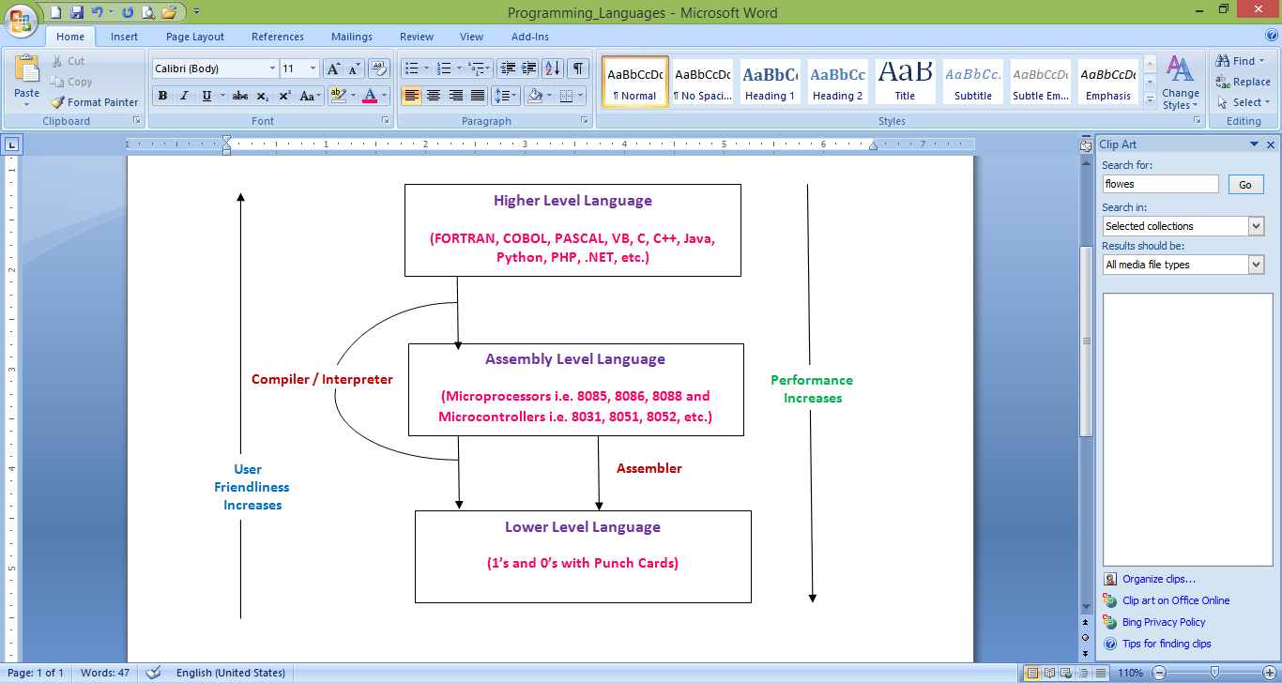
Programming Languages
Types of Programming Languages:

Slide 8
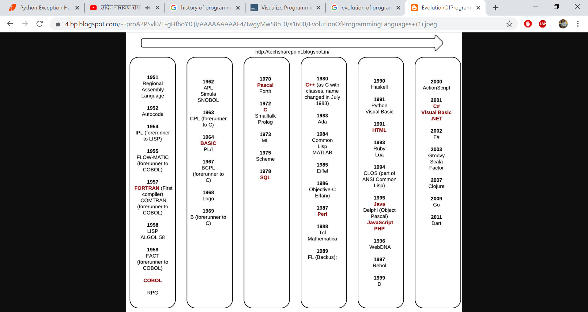
Timeline of HLLs

Slide 9
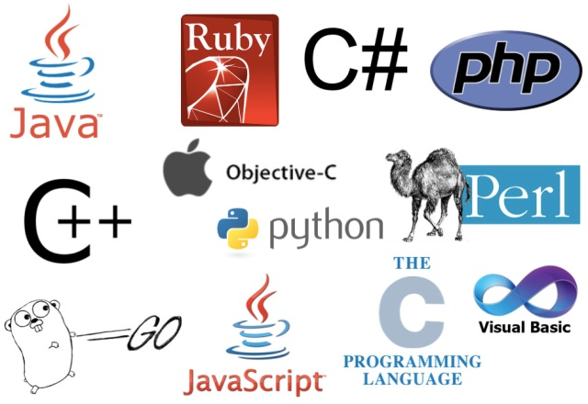
Some Popular HLLs

Slide 10
Structured v/s Object Oriented Programming Language

Slide 11
Procedure Oriented Program
Procedure-Oriented programming basically consists of writing a list of instructions (or actions) for the computer to follow, and organizing these instructions into groups known as functions.
While we concentrate on the development of functions, very little attention is given to the data that are being used by various functions.
What happens to the data? How are they affected by the functions that work on them?
In a multi function program, many important data items are placed as global so that they may be accessed by all the functions
Global data are more vulnerable to an accidental change by a function

Slide 12
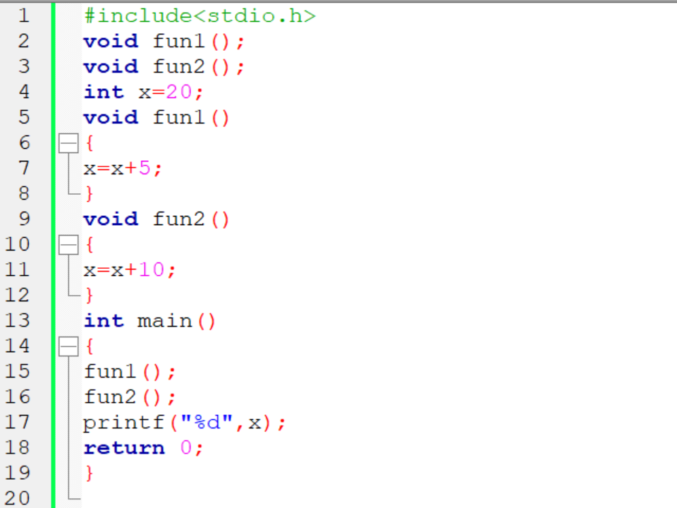
Procedure Oriented Program

Slide 13
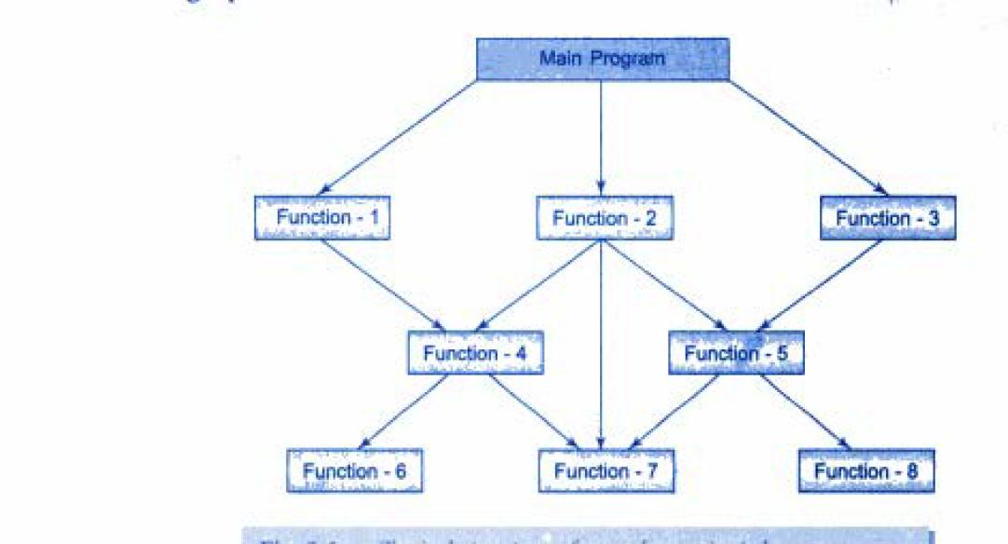
Procedure Oriented Program
Typical Structure of Procedure Oriented Program

Slide 14
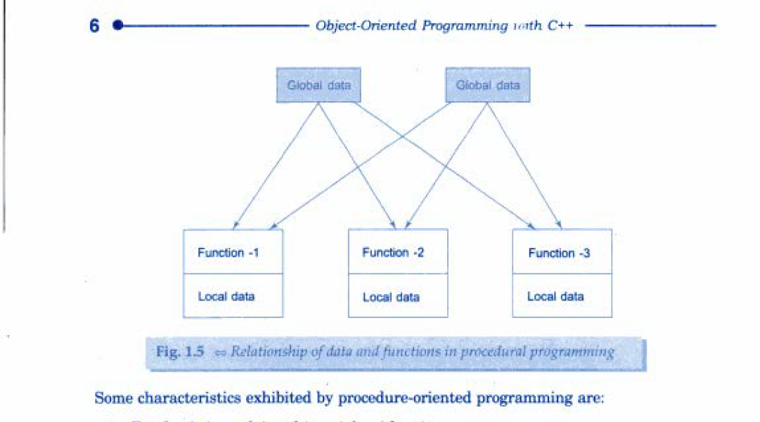
Procedure Oriented Program
Data and Functions in SOP

Slide 15
Object Oriented Program
The major motivating factor in the invention of object oriented approach is to remove some of the flaws encountered in the procedural approach.
OOP treats data as a critical element in the program development and does not allow it to flow freely around the system.
It ties data more closely to the function that operate on it, and protects it from accidental modification from outside functions.
OOP allows decomposition of a problem into a number of entities called objects and then builds data and functions around these objects.
The data of an object can be accessed only by the functions associated with that object.

Slide 16
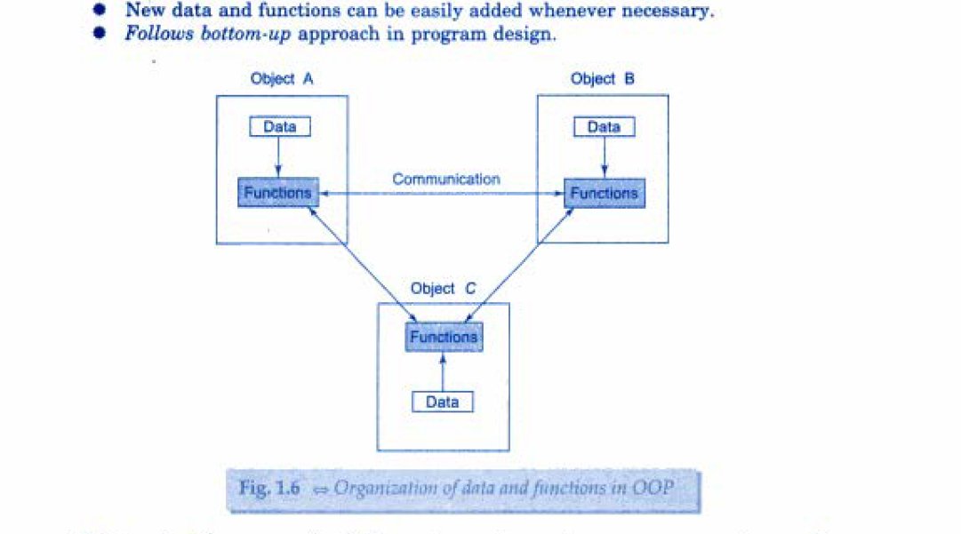
Object Oriented Program
Organization of Data in OOP

Slide 17
SOP v/s OOP
Sr. No | Structured Programming Language (SOP) | Object Oriented Programming Language(OOP)
1 | It is designed to focus on process/ logical structure and then data required for that process. | It is designed to focus on data.
2 | Follows top-down approach. | Follows bottom-up approach.
3 | Also known as Modular Programming and a subset of procedural programming language. | Supports inheritance, encapsulation, abstraction, polymorphism, etc.
4 | Programs are divided into small self-contained functions. | Programs are divided into small entities called objects.
5 | Function transform data from one form to another | Functions that operate on data of an object are tied together in a data structure

Slide 18
SOP v/s OOP
6 | Less secure as there is no way of data hiding. (most of the functions share global data) | More secure as having data hiding feature through access specifiers/modifiers i.e. private and protected
7 | Can solve moderately complex programs. | Can solve any complex programs.
8 | Provides less reusability, more function dependency. | Provides more reusability (due to inheritance), less function dependency.
9 | Less abstraction and less flexibility. | More abstraction and more flexibility( new data can functions can be added easily whenever required)
10 | Examples: FORTRAN, C, BASIC, PASCAL, etc. | Examples: C++, Java, PHP, .Net, Python, etc.

Slide 19
OOP Principles

Slide 20

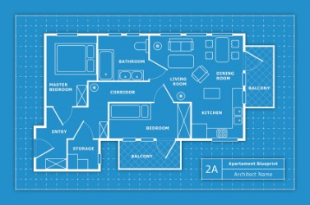
class
We can create a user defined data type in C++ using class
A class can be considered as a “Template” or “Blue Print” or “Dye” which declares data and code(function) inside it.
A class is a logical reality from which we can create n no. of instances i.e. from a dye, we can create so many idols, from a blue print (plan/design/pattern), we can construct so many buildings physically, etc. Thus a class is a collection of objects of similar types.

Slide 21

object
Basic run time entities in OOP i.e. a person, a bank, an employee, a student, etc.
Are variables of type class
Is a physical reality
Each object contains data and code(function) to manipulate data
Objects interact with each other by sending messages. i.e. a customer object can request an account object for the bank balance.

Slide 22
Data Encapsulation
The wrapping up of data and functions into a single unit (class) is known as Encapsulation
Only functions declared inside the class can access the data (outside interference is restricted – security)
Also called as “Data Hiding” or “Information Hiding”
The functions provide an interface between an object’s data and the program
Encapsulation is achieved trough access modifiers private and protected in C++

Slide 23
Data Encapsulation
Example: class employee
{ private:
int code;
char name[20];
float salary;
int experience;
public:
void setEmp();
void getEmp();
};
The attributes i.e. code, name, salary, experience are called as “data members”
The functions that operate on this data are called as “member functions ” or “ methods”

Slide 24
Data Abstarction
Act of representing essential features without including without including the internal details or explanations
Examples:
To drive a car without knowledge of Automobile Engineering
Using library functions in C/C++ - pow(), sqrt(), etc.
To use Internet, Smart Phones without knowing internal concepts
Classes use the concept of abstraction and are defined as a list of abstract attributes such as size, weight, and cost and functions to operate on these attributes i.e. employee class
To use the functionality of employee class, user is not worried about internal details rather he has to create an object and call the member functions
Due to this nature, class is called as an Abstract Data Type.

Slide 25
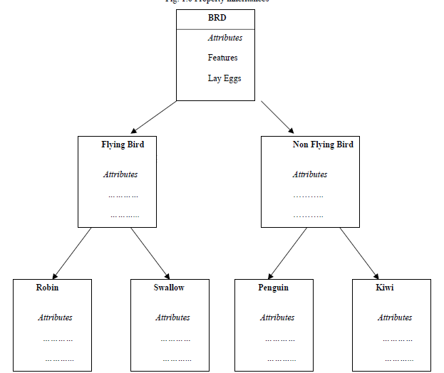
Inheritance
A process by which objects of one class acquire the properties of objects of another class
In biological terms “A child inherits qualities of its parent along with its own quality”. It is applicable to a class object as well.

Slide 26
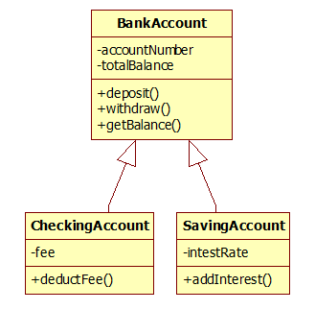
Inheritance
It provides the idea of Reusability which means we can add additional features to an existing class without modifying it.
It is possible by deriving a new class from the existing one which possesses qualities of both classes i.e. parent and child.

Slide 27
Polymorphism
It is a Greek term, means the ability to take more than one form
An operation may exhibit different behaviors in different
Instances
The behavior depends upon the types of data used in the operation. For example, consider the operation of addition. For two numbers, the operation will generate a sum. If the operands are strings. then the operation would produce a third string by concatenation.
The process of making an operator to exhibit different behaviors in different instances is known as operator overloading [Compile Time Polymorphism]

Slide 28
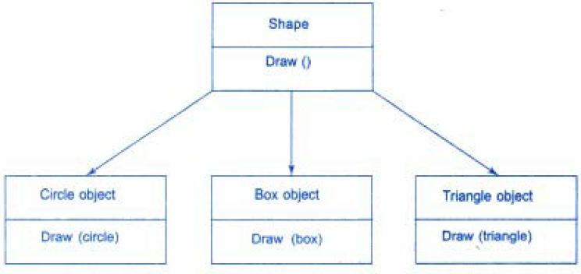
Polymorphism
A single function name can be used to handle different number
and different types of arguments. (i.e. a particular word having several different meanings depending on the context)
Using a single function name to perform different types or tasks is known as function overloading
A single function name can be used to handle different number
and different types of arguments. (i.e. a particular word having several different meanings depending on the context)
Using a single function name to perform different types or tasks is known as function overloading [Compile Time Polymorphism]

Slide 29
“A general class of operations may be accessed in the same manner even though specific actions associated with each operation may differ”

Slide 30
Dynamic Binding
Binding refers to the linking of a procedure(function) call to the code to be executed in response to the call.
Dynamic binding (also known as late binding) means that the code associated with a given procedure call is not known until the time of the call at run-time.
Functions with same signature (name as well as no. and type of arguments are same) or prototype are called as “virtual functions.”
It is associated with run time polymorphism and inheritance.

Slide 31
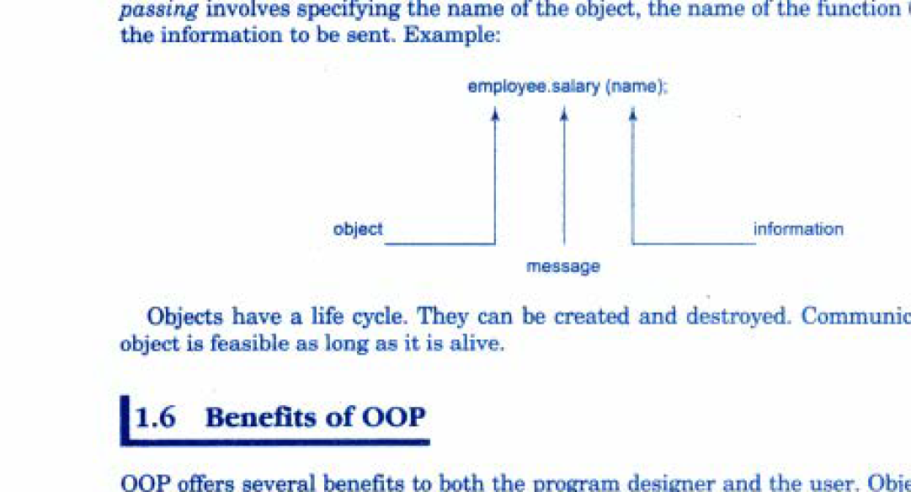
Message Passing
Object Oriented Programming involves following basic steps:
Creating classes that define objects and their behavior
Creating objects from the classes
Establishing communication among objects
Objects communicate with one another by sending and receiving information much the same way as people pass messages to one another.
Message passing involves specifying the name of the object, the name of the function (message) and the information to be sent.
Example:

Slide 32
Benefits of OOP
Security in code due to data hiding
Multiple objects can co-exist without interference
Objects can be directly map with real world entities of given problem statement
Work can be partitioned on the basis of objects
Data centered design enables to capture more details in implementable form
Object oriented systems can be easily upgraded from small to large systems
Software complexity can be easily managed.

Slide 33
Applications of OOP
Real Time Systems
Simulation and Modeling
Object Oriented Databases
AI and Expert Systems
Decision Support and Office Automation Systems
CIM/CAM/CAD Systems

Slide 34
History of C++
C++ is an object-oriented programming language.
Developed by Bjarne Stroustrup at AT&T Bell Laboratories in Murray Hill, New Jersey, USA, in the early 1980's.
Stroustrup, an admirer of Simula67 and a strong supporter of C, wanted to combine the best of both the languages created a more powerful language that could support object-oriented programming features and still retain the power and elegance of C. The result was C++.
Stroustrup initially called the new language 'C with classes'.
Later in 1983, the name was changed to C++.
The idea of C++ comes from the C increment operator ++, an augmented (incremented) version of C.

Slide 35
Introduction to C++
During the early 1990's the language underwent a number of improvements and changes.
In November 1997, the ANSI/ISO standards committee standardized these changes and added several new features to the language specifications
The most important facilities that C++ adds on to C are classes, inheritance, function overloading, and operator overloading

Slide 36
Structure of a C++ Program

Slide 37
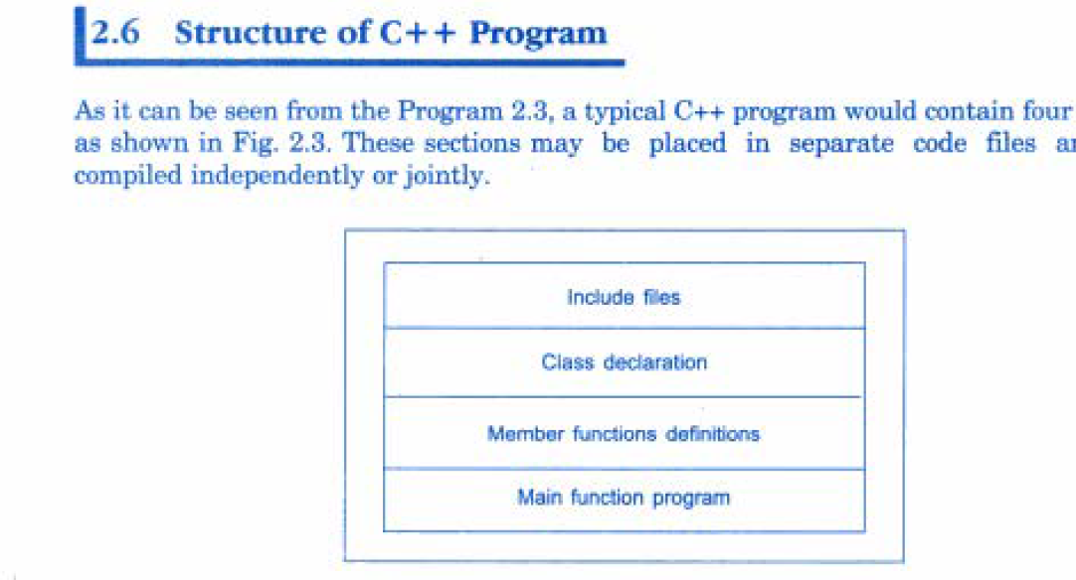
Structure of a C++ Program

Slide 38
A Sample C++ Program
In Turbo C++/Borland C++
#include<iostream.h>
void main()
{
cout<<“Hello World\n”;
}
Compilation and Execution is same as C

Slide 39
A Sample C++ Program
In UNIX/LINUX or CodeBlocks IDE
#include<iostream>
using namespace std;
int main()
{ cout<<“Hello World\n”;
return 0;
}
Compilation in UNIX/LINUX: g++ -o Hello Hello.cpp
g++ = C++ Compiler (for C program gcc)
-o = output file (i.e. Hello)
Hello.cpp = Source file to be compiled
Execution in UNIX/LINUX: ./Hello
Note: In CodeBlocks IDE, key commands are there to compile and execute a C++ program

Slide 40
A Sample C++ Program
<iostream.h> or <iostream>
The header file iostream should be included at the beginning of all programs that use input/output statements.
lt contains declarations for the identifier cout and the operator << (output) as well identifier cin and operator >> (input)
Name Space:
A new concept introduced by the ANSI C++ standards committee.
Defines a scope for the identifiers that are used in a program. For using the identifiers defined in the namespace scope we must include the using directive, like
using namespace std;
Here, std is the namespace where ANSI C++ standard class libraries are defined.
All ANSI C++ programs must include this directive. This will bring all the identifiers defined in std to the current global scope.

Slide 41
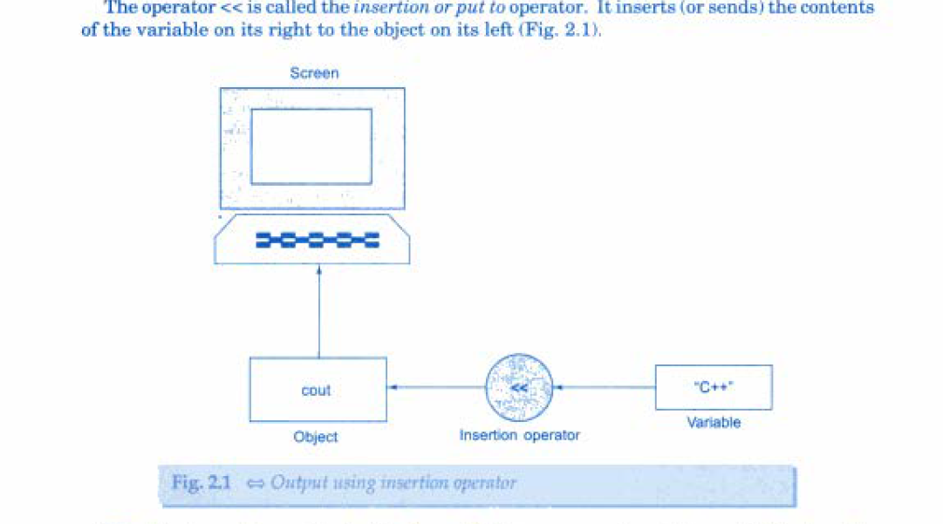
Output Operator
The C++ introduces two new features, cout and <<.
The identifier cout (pronounced as 'C out') is a predefined object that represents the standard output stream in C++ i.e. the screen (console). It is also possible to redirect the output to other output devices
The operator<< is called the insertion or put to operator. It inserts (or sends) the contents of the variable on its right to the object on its left.

Slide 42
Adding Two Numbers
#include<iostream>
using namespace std;
int void main()
{
int a=2,b=3,c;
c=a+b;
cout<<c;
//cout<<“Addition of ”<<a<<“ and ”<<b<<“ = ”<<c;
return 0;
}

Slide 43
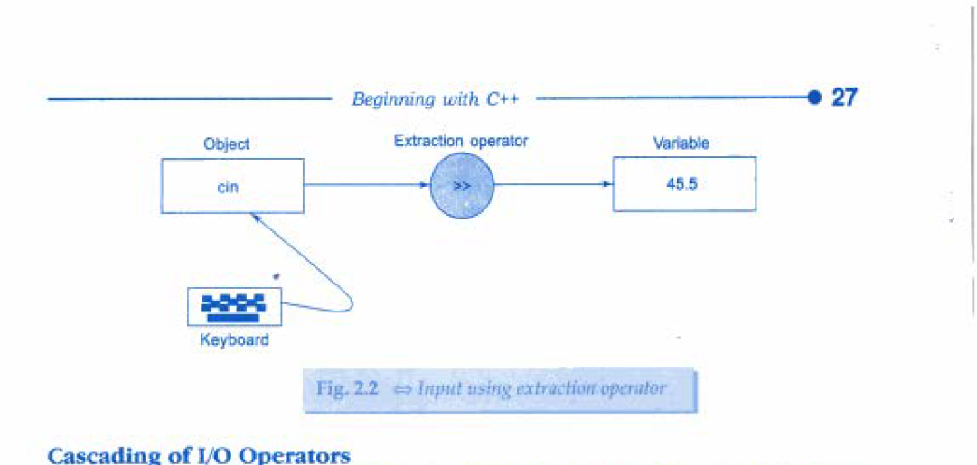
Input Operator
The statement: cin>>num; is an input statement and causes the program to wait for the user to type in a number. The number keyed in is placed in the variable num.
The identifier cin (pronounced 'C in ') is a predefined object in C++ that corresponds to the standard input stream. i.e. the keyboard.
The operator >> is known as extraction or get from operator.
It extracts (or takes) the value from the keyboard and assigns it to the variable on its right ( like scanf() in C)

Slide 44
Adding Two Numbers
#include<iostream>
using namespace std;
int main()
{
int a,b,c;
cout<<“Enter two numbers\n”;
cin>>a>>b;
c=a+b;
cout<<“Addition of ”<<a<<“ and ”<<b<<“ = ”<<c;
return 0;
}

Slide 45
C++ IDES

Slide 46
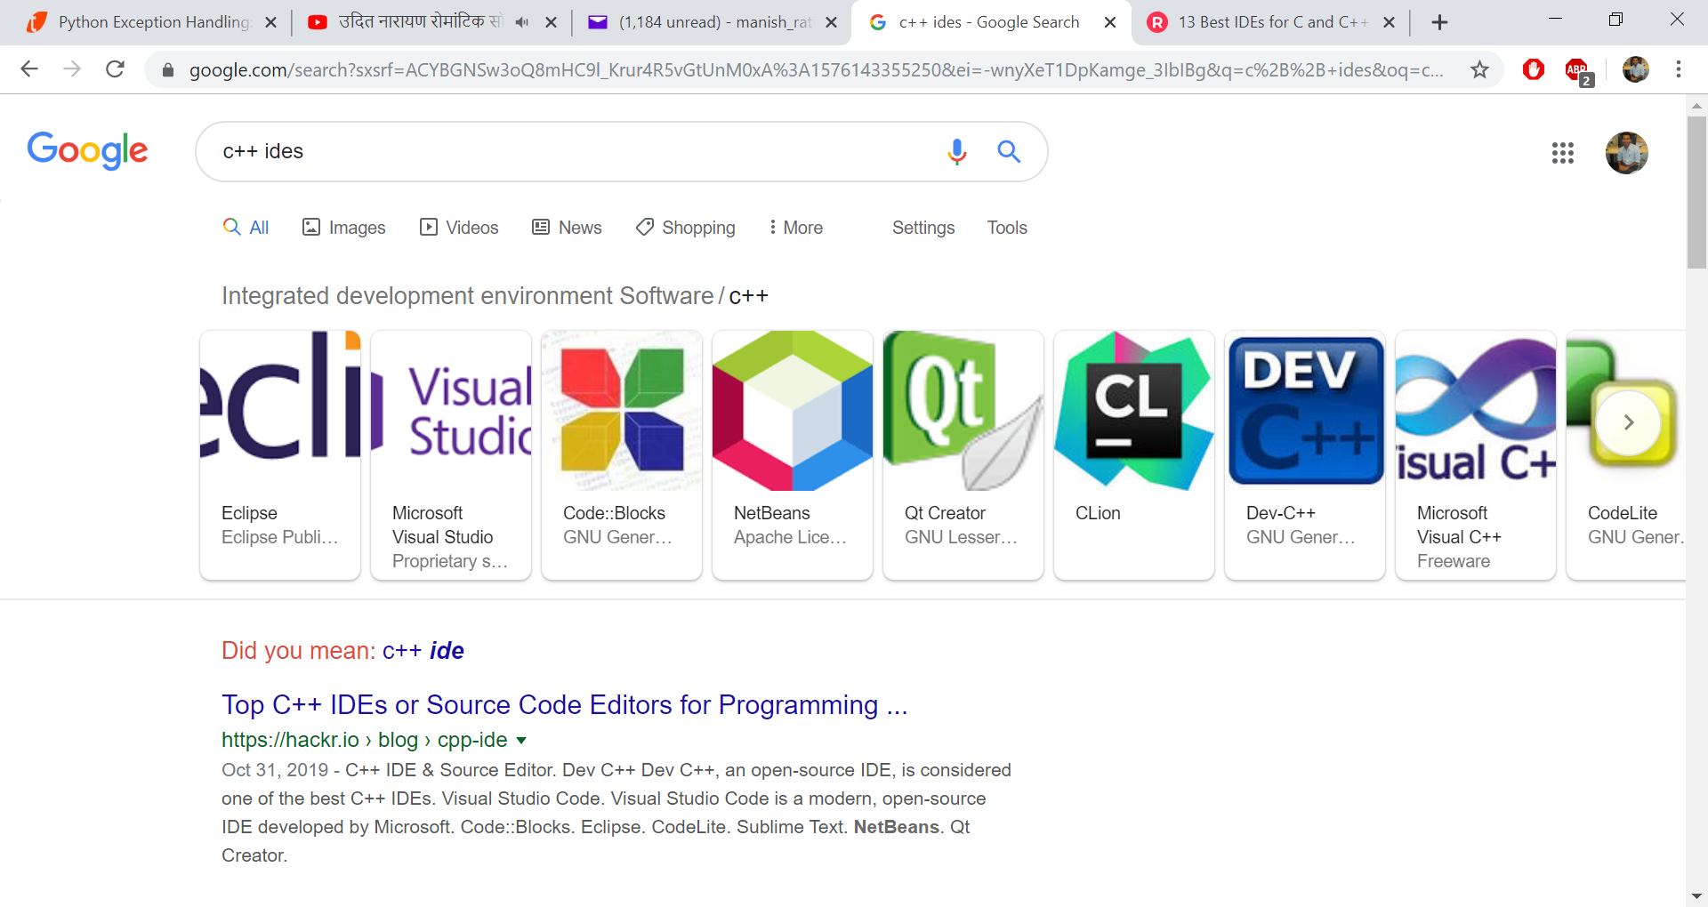
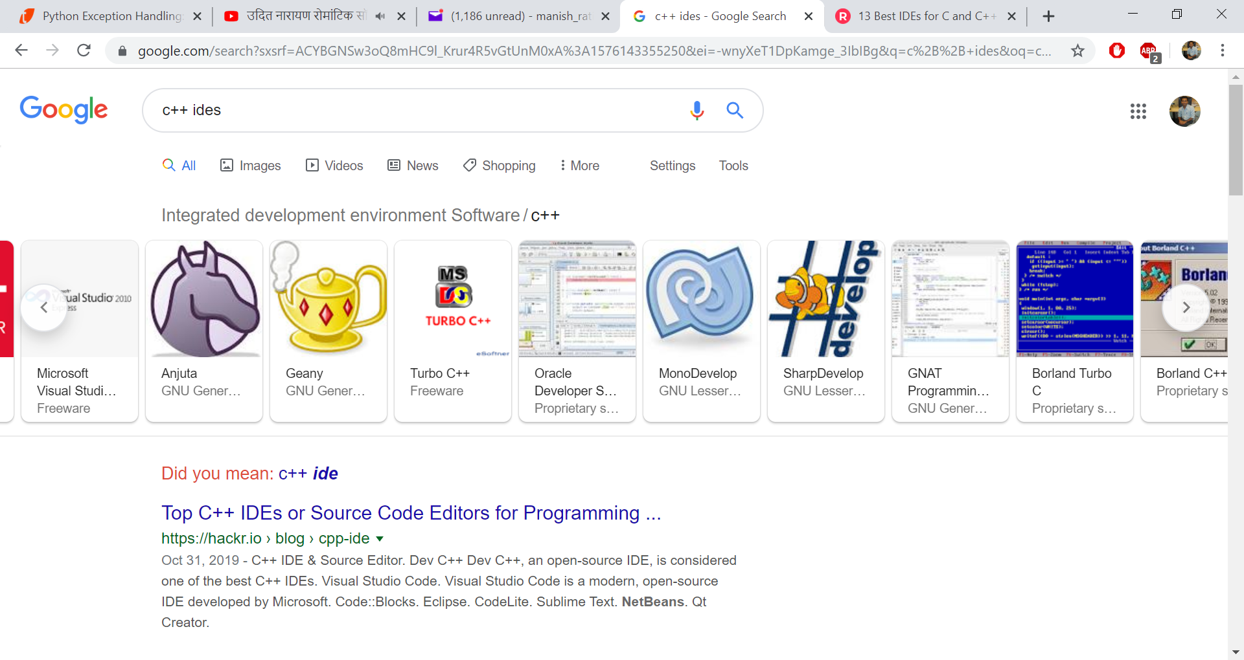
C/C++ IDEs

Slide 47
Turbo C++ Code
#include<iostream.h>
void main()
{
int a,b,c;
cout<<“Enter two numbers\n”;
cin>>a>>b;
c=a+b;
cout<<“Addition of ”<<a<<“ and ”<<b<<“ = ”<<c;
}

Slide 48
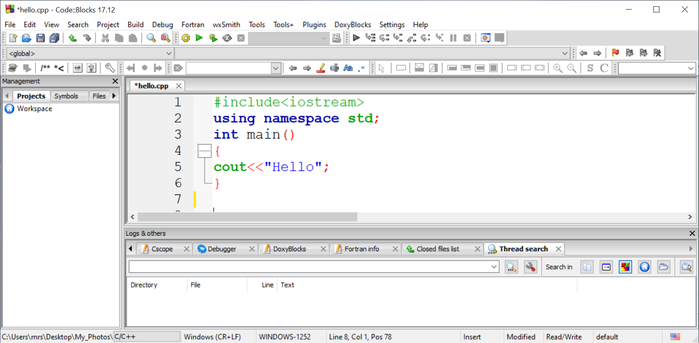
Code::Blocks Code

Slide 49
Credits
Object oriented programming with C++, E Balagurusamy, Tata McGraw-Hill Publishing Company Limited, New Delhi

